Slide 1
Welcome
To
Project - 6
Pharmaceutical Sales prediction across multiple stores
Name – Mohd Jubair Khan
Date – 20 – 10 - 2024

Slide 2
Abstract
This project focuses on predicting sales for pharmaceutical stores using a dataset consisting of historical sales, promotional activities, and store characteristics. The data comprises multiple features: store details, daily operations, customer information, and external factors such as holidays and competition. The training dataset includes features like sales numbers, number of customers, promotions, and holidays, while the test dataset omits the sales values for prediction purposes. Store-specific data, including assortment type, competition details, and participation in promotional programs, further enrich the analysis.
By leveraging machine learning models, we aim to develop a robust prediction model that can accurately forecast sales based on store-level and external factors. The project explores the impact of promotions, holidays, competition, and customer behavior on sales, with an emphasis on identifying patterns that can help optimize promotional strategies and inventory management. Additionally, the project involves exploratory data analysis to uncover trends and insights, such as the correlation between customer numbers and sales or the influence of store location and competition on performance.

Slide 3
Content
1. Introduction
2. Objectives
3. Methods
4. Results
5. Conclusions
Chapter - 1
1. Introduction
Accurately predicting sales is crucial for pharmaceutical retailers to optimize inventory, manage promotional strategies, and meet customer demand. In this project, we aim to develop a predictive model for forecasting sales in pharmaceutical stores, leveraging a comprehensive dataset containing store-specific information, daily sales data, promotional activities, and external factors such as holidays and competition.
The dataset is divided into several components:
Training Data: This dataset includes information such as sales figures, customer counts, store operational details (open or closed status), and whether the store was running a promotion. Additionally, it captures the impact of state and school holidays on sales.
Test Data: This dataset is similar to the training data but excludes the sales figures, serving as the basis for generating future sales predictions.

Slide 4
Store Data: This dataset provides supplementary information about each store, including the store type, assortment level, the proximity of competitors, and whether the store participates in extended promotional programs.
Sample Submission Data: This dataset provides a format for the submission of predicted sales values for the test data.
The primary goal of this project is to predict sales for stores using machine learning techniques. By analyzing how factors such as promotions, holidays, store assortment, and competition influence sales, we aim to provide pharmaceutical retailers with insights into customer purchasing behavior. Understanding these relationships will allow retailers to better forecast demand, plan inventory, and design effective promotional strategies, ultimately improving overall operational efficiency.
In this study, we will also perform exploratory data analysis (EDA) to identify patterns and correlations in the data. This includes investigating how different factors, such as store location and competitor presence, affect sales. Additionally, the model will be fine-tuned to account for the seasonal trends and external factors influencing pharmaceutical sales.

Slide 5
Chapter - 2
2. Objectives:
Here are potential objectives for your pharmaceutical sales prediction project based on the provided data:
1. Sales Prediction: Develop a machine learning model to accurately predict daily sales for pharmaceutical stores based on historical sales data, promotions, holidays, and other store-specific features.
2. Promotion Effectiveness Analysis: Analyze the impact of various promotional strategies on sales and customer behavior, identifying which promotions lead to the highest sales increase.
3. Holiday Impact Assessment: Investigate the influence of public holidays (StateHoliday and SchoolHoliday) on sales patterns, both before and after the holidays, to inform inventory and staffing decisions during these periods.
4. Customer Behavior Analysis: Explore the correlation between the number of customers and sales, understanding how factors such as store operational days, promotions, and holidays affect customer traffic.

Slide 6
5. Competition Analysis: Assess the effect of competitor presence, including the distance to competitors and timing of competitor openings, on store sales, with a focus on stores located in city centers or near new competitors.
6. Seasonal Sales Trends: Identify and model seasonal purchasing behaviors, such as increased sales during Christmas and Easter, to help stores plan for demand fluctuations.
7. Assortment and Store Type Evaluation: Examine how different store assortments (product variety) and store types (e.g., large vs. small stores) influence sales performance, to recommend store-specific inventory strategies.
8. Prediction Deployment: Design a user-friendly interface (e.g., Flask or Streamlit app) for deploying the trained model, enabling store managers to input relevant parameters and receive accurate sales forecasts.
9. Outlier and Anomaly Detection: Clean the dataset by detecting and handling outliers and anomalies in sales data, ensuring that predictions are based on realistic trends.
10. Model Optimization: Fine-tune the prediction model using cross-validation and hyperparameter tuning to maximize accuracy, ensuring the model performs well on unseen test data.

Slide 7
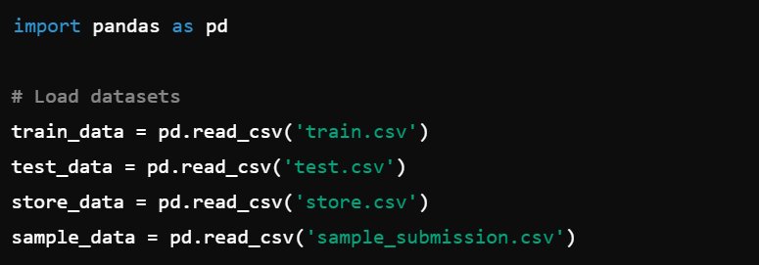
Chapter - 3
3. Methods
(i). Loading the Data:
The first step in this project is to load the various datasets, which include the training data, test data, store information, and sample submission data. These datasets are stored in CSV format and are loaded into Python using the pandas library. The datasets are then stored as DataFrames for further analysis.

Slide 8
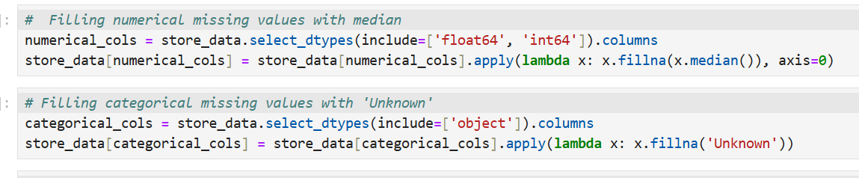
(ii). Cleaning the Data:
Before performing any analysis or modeling, it is essential to clean the datasets to ensure that they are free from inconsistencies, missing values, and duplicates. This process improves the accuracy and reliability of the subsequent analysis and predictions.
(a). Handling Missing Values:
The datasets contain several missing values, particularly in the store_data, where details like CompetitionDistance, CompetitionOpenSinceYear, Promo2SinceYear may be incomplete for some stores. Missing values are handled by applying appropriate imputation techniques:

Slide 9
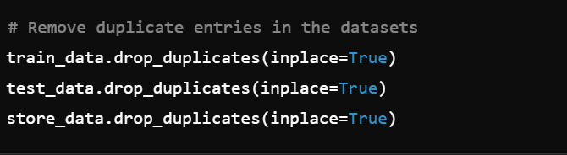
(b). Removing Duplicates:
Duplicate entries, if present, can introduce bias into the model and negatively impact its performance. To address this, we check for and remove any duplicate rows in the datasets.

Slide 10
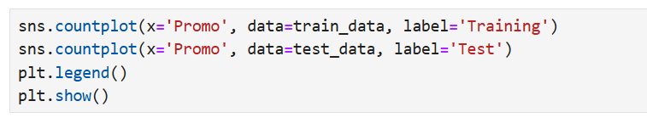
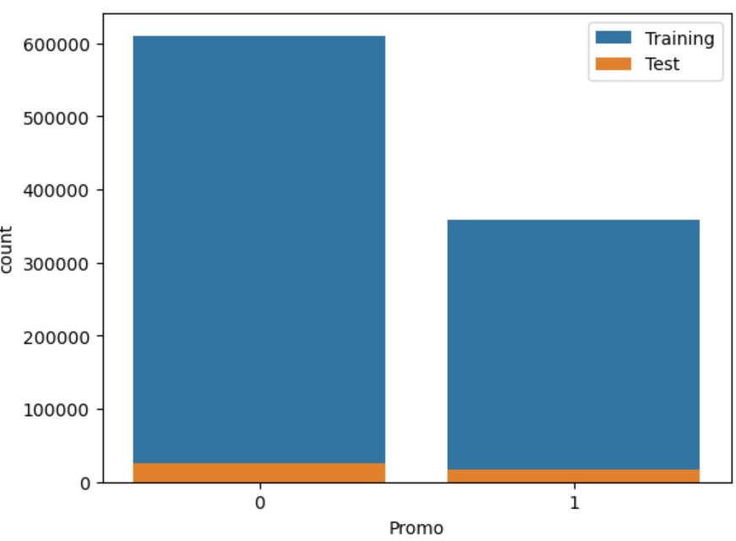
Task 1 - Exploration of customer purchasing behaviour:
1.1- Distribution of Promotions in Training and Test Sets: Compare the distribution of the promo feature between the training and test datasets to check for any significant differences. This will ensure the model is trained and tested on similar data.

Slide 11
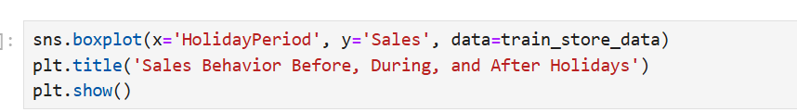
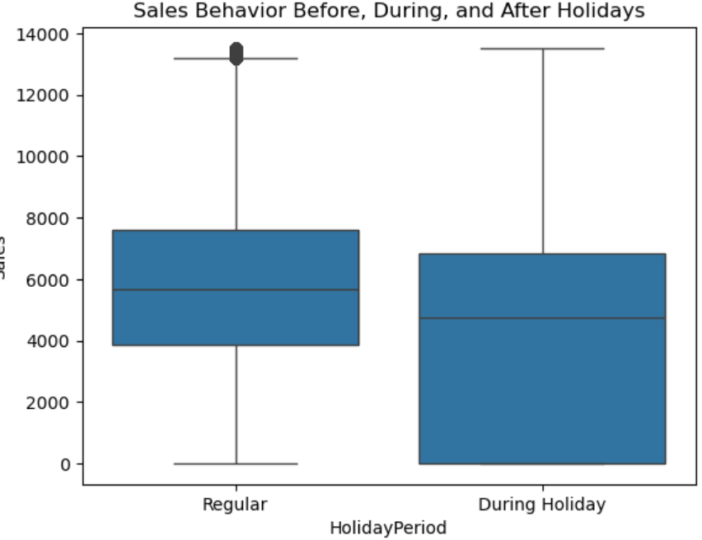
1.2- Sales Behavior Before, During, and After Holidays: Group sales data based on StateHoliday and SchoolHoliday features and compare the sales before, during, and after holidays. This can reveal the impact holidays have on customer purchases.

Slide 12
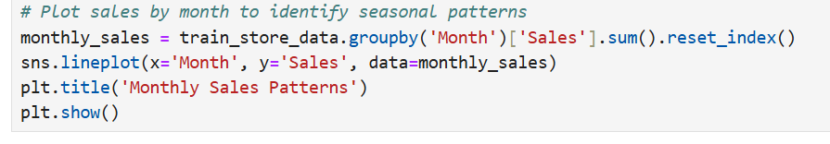
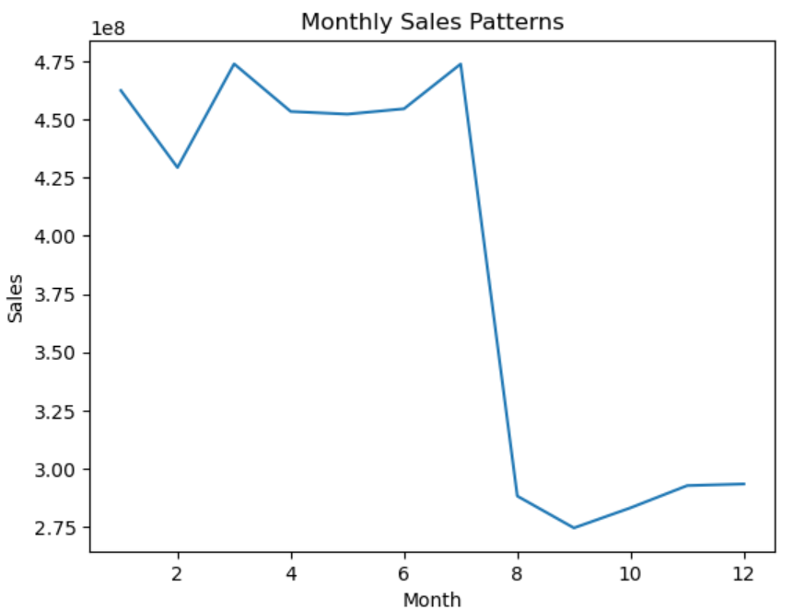
1.3. Seasonal Purchase Behaviors (Christmas, Easter, etc.): use the date column to extract seasons or specific holiday periods such as Christmas or Easter. Then, analyze sales behavior during these seasons.

Slide 13
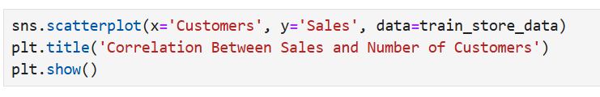
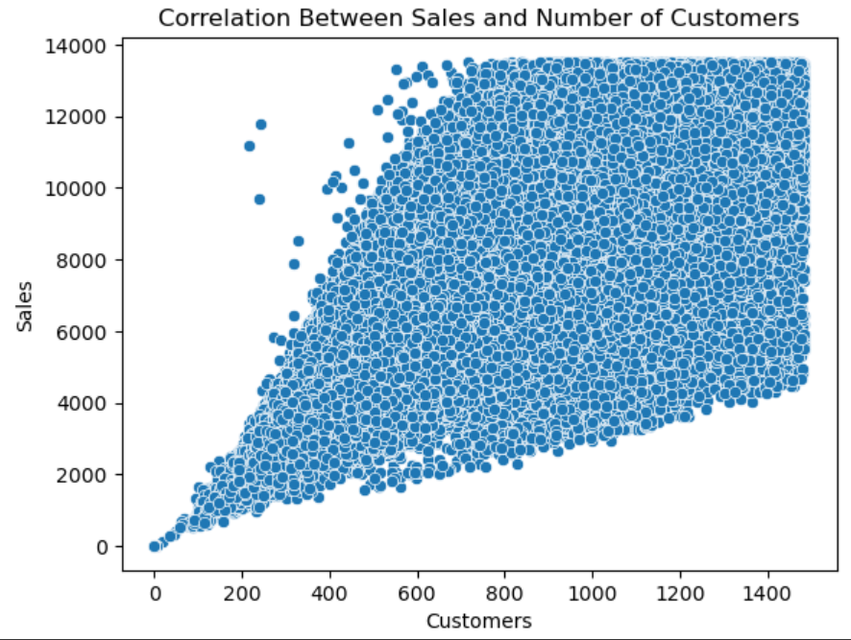
1.4- Correlation Between Sales and Number of Customers: Use correlation analysis to determine the relationship between sales and customers. A scatter plot can visualize the strength of this correlation.

Slide 14
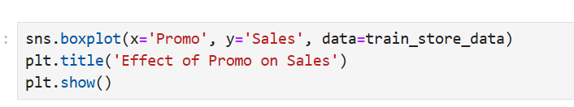
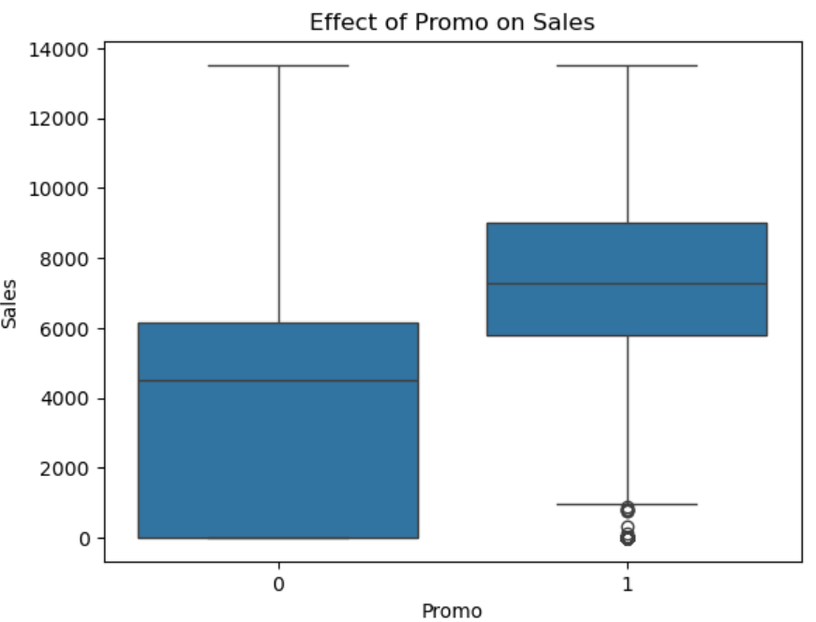
1.5- Effect of Promotions on Sales: Analyze how promotions (promo feature) affect sales and whether they attract new customers or simply increase the spending of existing ones. You can compare sales during promo periods vs. non-promo periods.

Slide 15
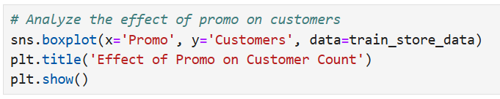
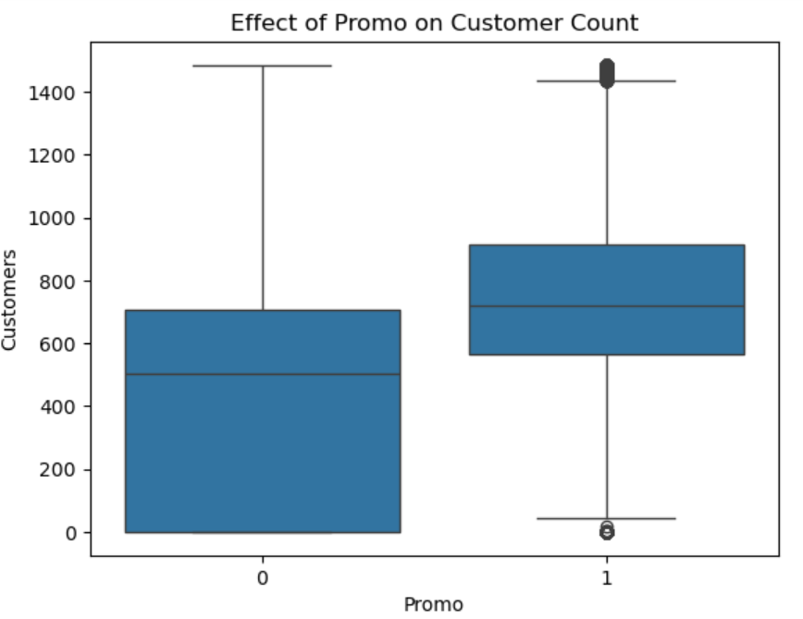
1.6- More Effective Promo Deployment: Explore which stores or store types respond better to promotions. For example, are stores in city centers benefiting more from promotions compared to suburban stores?

Slide 16
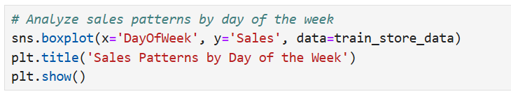
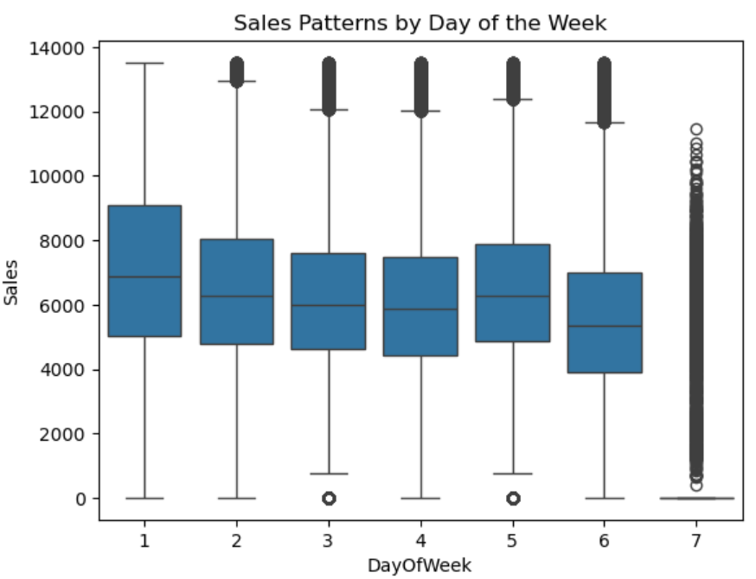
1.7- Customer Behavior During Store Open and Closing Times: Analyze customer behavior around store opening and closing times using the open eature and examine sales during those periods.

Slide 17
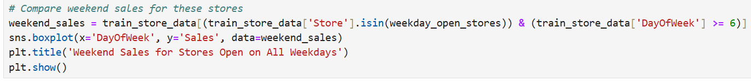
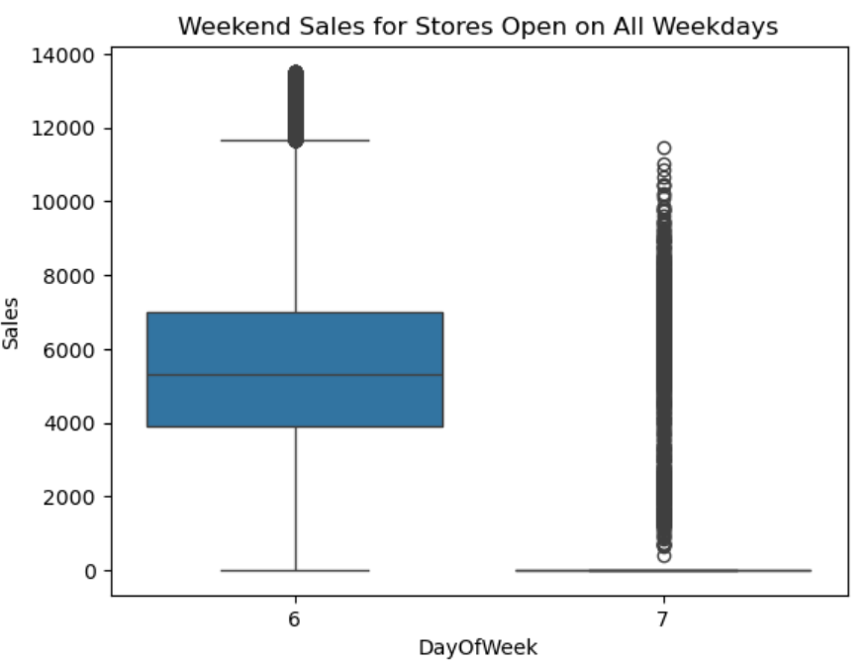
1.8- Store Opening on Weekdays vs. Weekend Sales: Analyze stores that are open on weekdays and whether it impacts weekend sales. Group stores based on their open status and calculate their weekend sales.

Slide 18
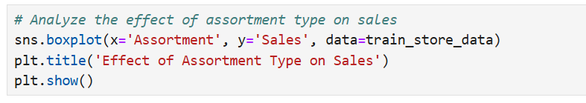
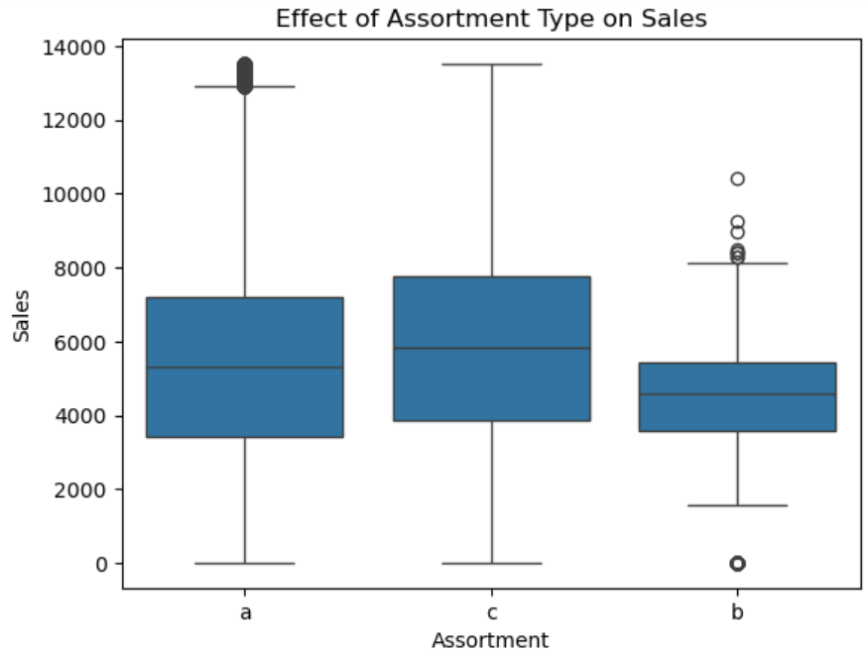
1.9- Effect of Assortment Type on Sales: Group sales based on the assortment future in the store_data and analyze whether certain assortment types drive higher sales.

Slide 19
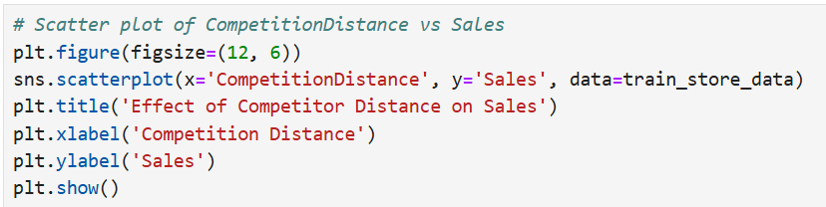
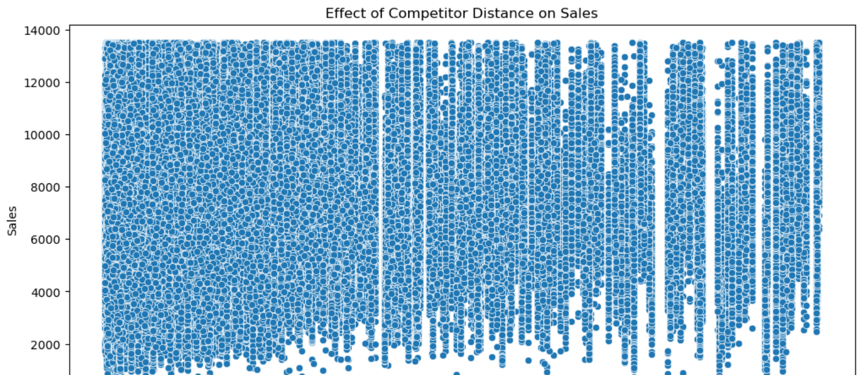
1.10- Effect of Competitor Distance on Sales: Investigate how the CompetitionDistance impacts sales and whether it has a different effect on stores located in city centers compared to suburban areas

Slide 20
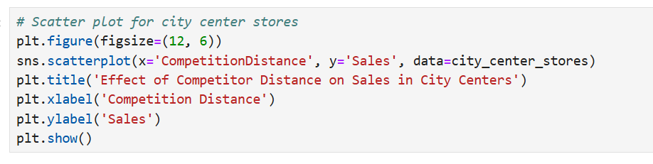
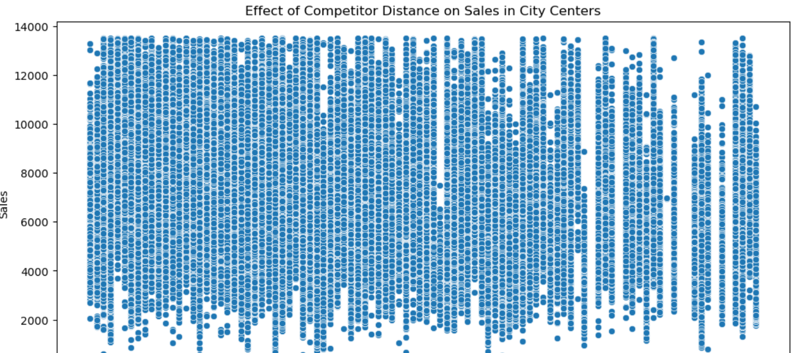
1.11- Impact of Competitor Opening or Reopening: Examine whether the opening or reopening of new competitors has an impact on store sales. Track stores with missing values in CompetitionDistance and analyze their performance after competitors are introduced.

Slide 21
Findings
The most selling and crowded store type is b.
2. The most selling and crowded assortment is b.
3. Sales is highly correlated to customers.4.
For all stores, promotion leads to increase in Sales and Customers. But promotions have low impact on store type b and assortment b when comparing to the other store types and assortments. So promotions should be applied more in the other store types and assortments.
5. Store type b is the most opened store type on all weekdays and has its highest sales on sundays than the other days.
6. Assortment a and b are the most opened assortments on all weekdays and have their highest sales on sundays than the other days. The number of cusomers increase dramatically on sundays for assortment a while it is similar with other week days for assortment b.
7. Sales are increased during Chirstmas week, especially the week before. This might be due to the fact that people buy more beauty products or some common medicines for precaution during Christmas celebration.
8. Stores with the smallest competition distance have the highest sales. This indicates that the stores are located at city center or near hospitals. Even though having large distance between competitors is ideally considered great for sales, stores located at city centers will still get more sales regardless of competitors distance as there are more customers at city centers.

Slide 22
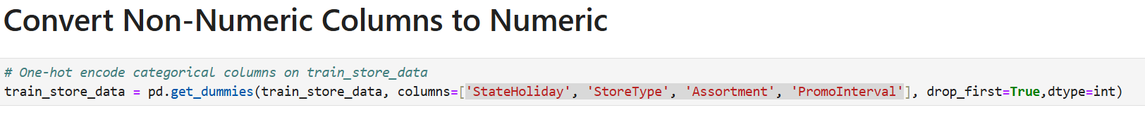
Task 2- Prediction of store sales:
Accurately predicting store sales is vital for effective business planning, allowing the company to manage inventory, staffing, promotions, and resource allocation ahead of time. This task entails forecasting daily sales in multiple stores over the upcoming six weeks. Below is an outline and solution plan for each step involved.
2.1- Preprocessing: Effective preprocessing is essential to make the dataset compatible with machine learning models. This step involves several tasks:
1. Encoding Non-Numeric Columns: Convert categorical columns to numeric representations. You could use one-hot encoding for columns with nominal (data'StateHoliday', 'StoreType', 'Assortment', 'PromoInterval’).

Slide 23
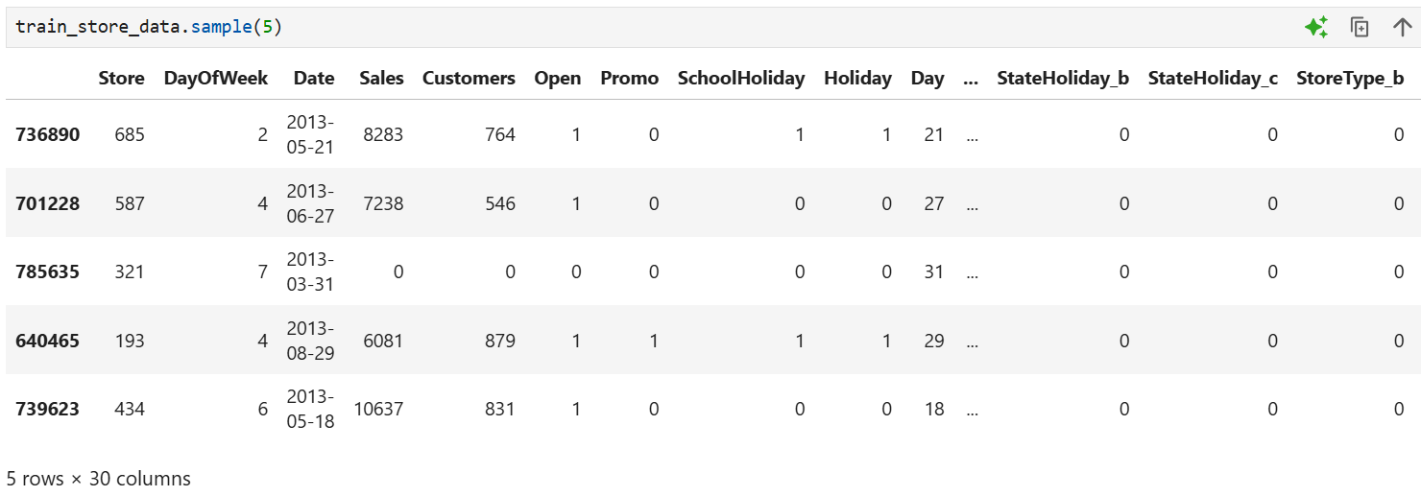
2. Generating New Features from Date Columns: Date information often contains valuable seasonal and temporal patterns. Extract the following features to enhance predictive power:
Weekday: Whether a day is a weekday or weekend.
Days to Holidays and Days after Holiday: Calculate proximity to public holidays or known shopping events to capture spikes in sales.
Month Position: Identify start, middle, and end of month to account for payday effects.
Other temporal features like the day of the week and whether it’s a holiday.

Slide 24
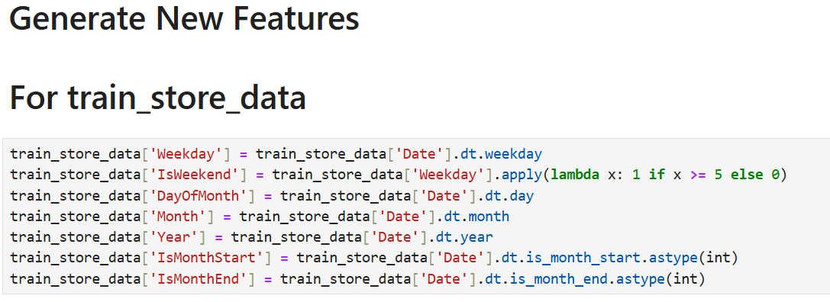
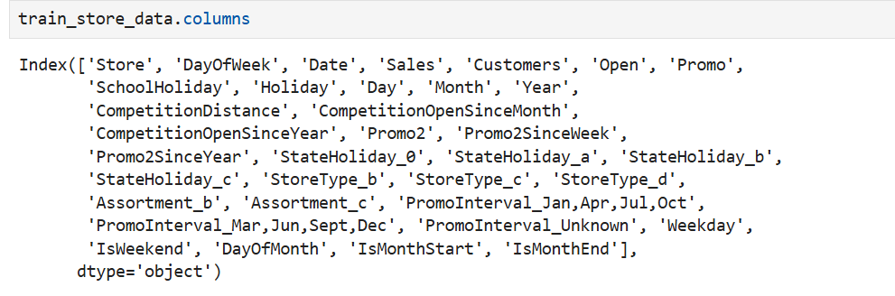

Slide 25
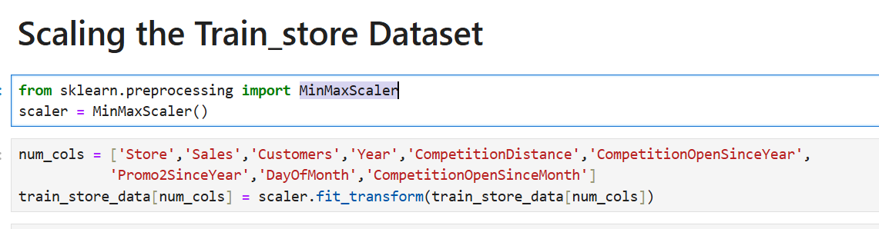
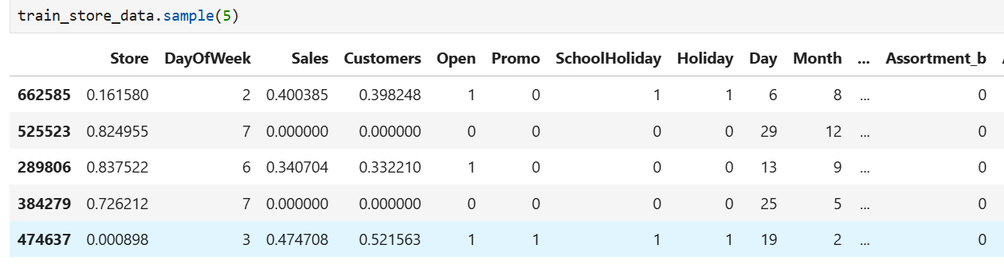
3. Scaling the Data: using a MinMaxScaler scaler to standardize the features allows for smoother convergence in distance-based algorithms, especially when using tree-based models or neural networks.

Slide 26
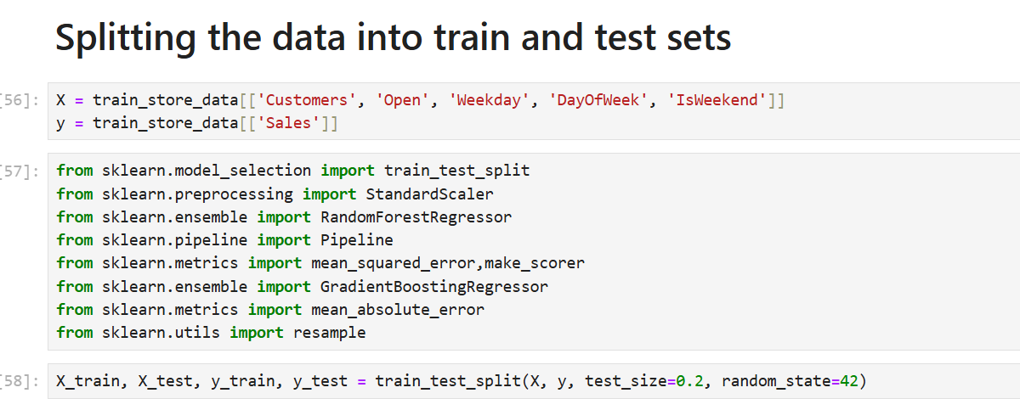
2.2 Building Models with sklearn Pipelines: After preprocessing, we can model the data. A pipeline structure in sklearn helps streamline the process, making it modular and simplifying future adjustments or file migrations.

Slide 27
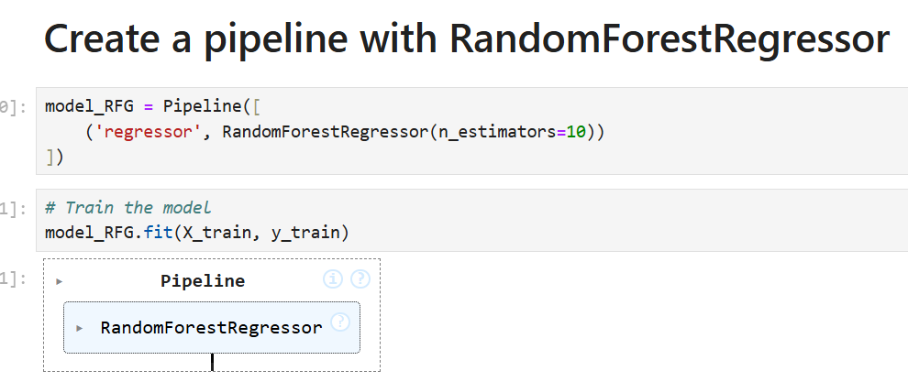
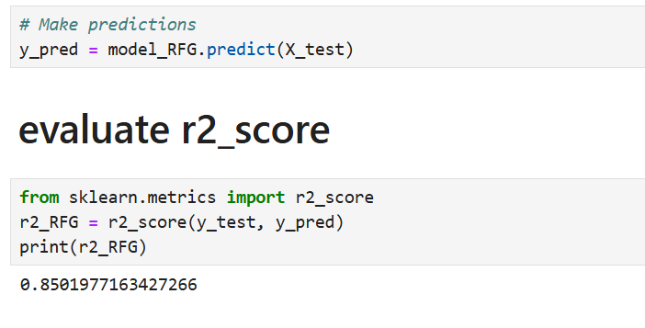
1. Create a pipeline with RandomForestRegressor

Slide 28
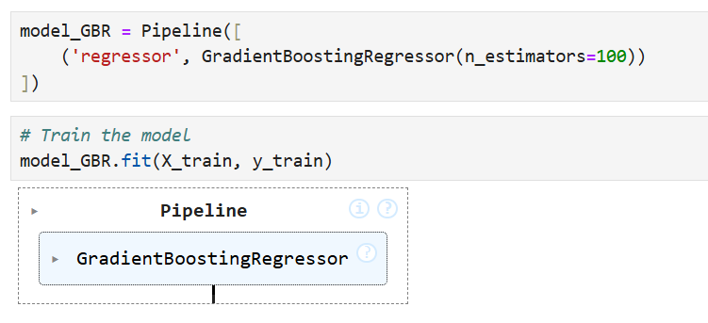
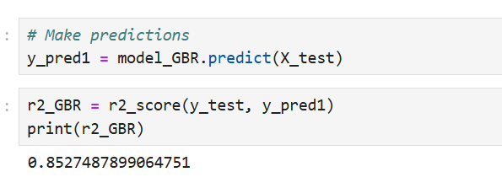
2. Create a pipeline with GradientBoostingRegressor:

Slide 29
Findings:
The model pipeline ensured a smooth workflow, from preprocessing to model training.
Gradient Boosting Regressor showed strong performance on the training data, capturing complex interactions between features.
2.3 Choose a Loss Function: Choosing an appropriate loss function is key to accurate predictions. For sales prediction, commonly used loss functions are:
Mean Absolute Error (MAE): Measures the average magnitude of errors in predictions without considering their direction. It’s particularly useful if you’re looking for an interpretable, dollar-value impact of errors.

Slide 30
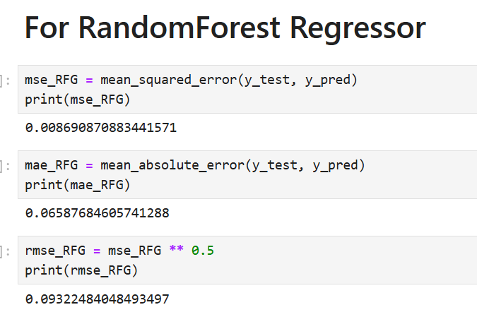
Mean Squared Error (MSE): Penalizes larger errors more heavily and can be effective if we want to prioritize extreme deviations. This could be useful in cases where large sales mispredictions are particularly harmful.
Mean Absolute Percentage Error (MAPE): Provides error as a percentage, which could be beneficial for comparing errors across different scales.

Slide 31
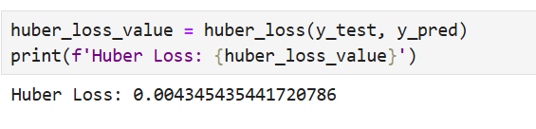
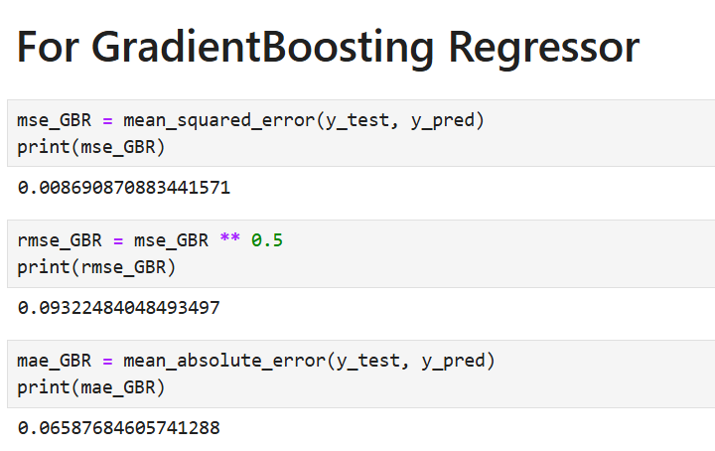
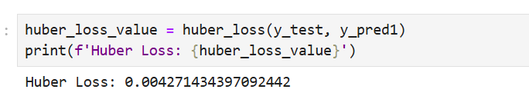

Slide 32
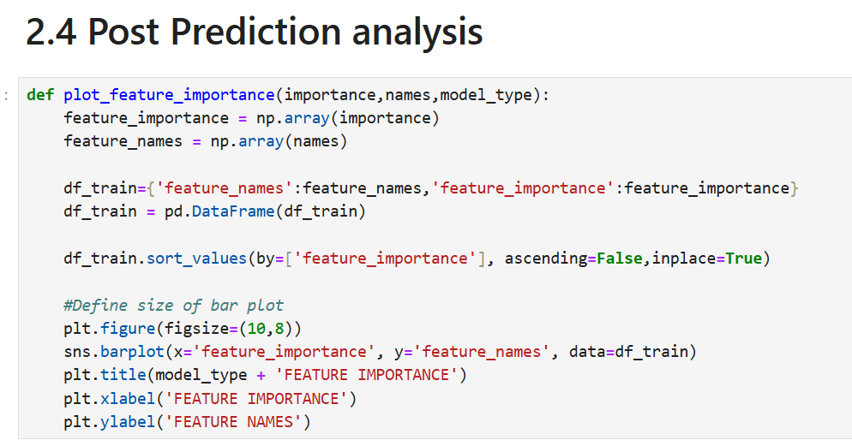
2.4 Post-Prediction Analysis: Once the model is built and evaluated, analyzing feature importance and prediction confidence can yield further insights:
Feature Importance: Feature importance can be derived directly from tree-based models (e.g., feature importance attribute in RandomForestRegressor This helps in understanding which factors are the most influential for sales.
Estimating Confidence Intervals: A creative approach for confidence estimation in predictions could involve using Bootstrap Aggregation (Bagging), resampling data, and generating multiple predictions to observe variability. Another method could involve using Prediction Intervals, which give a probabilistic range for future predictions.

Slide 33
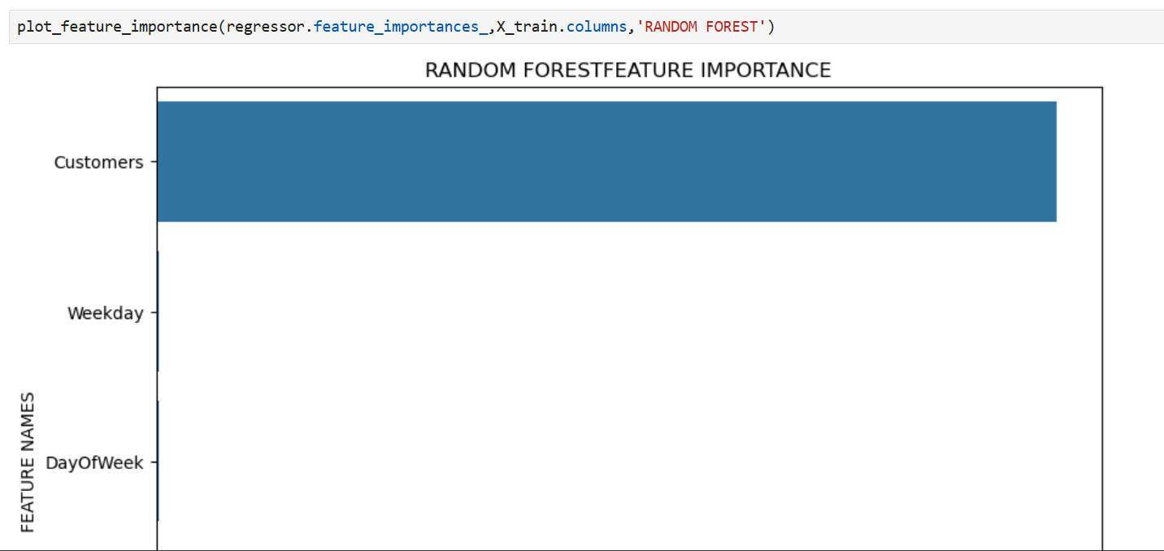

Slide 34
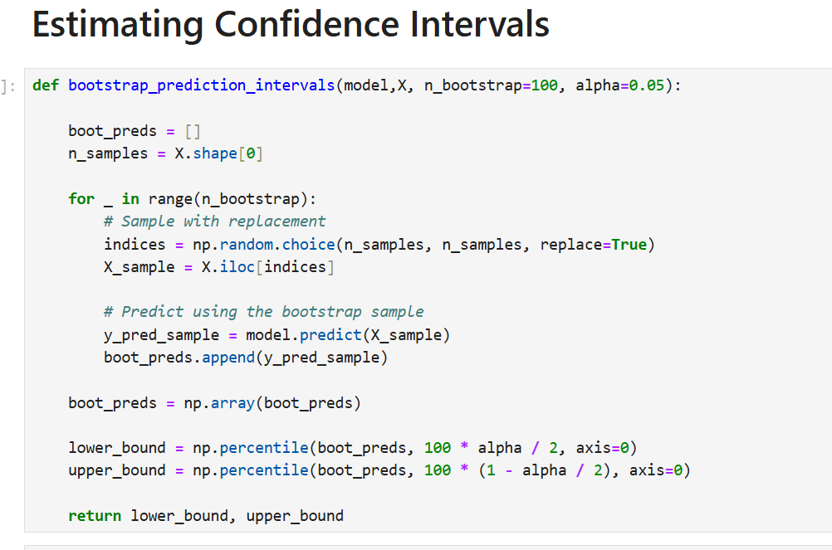

Slide 35
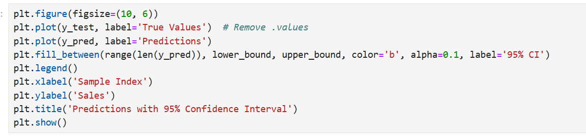
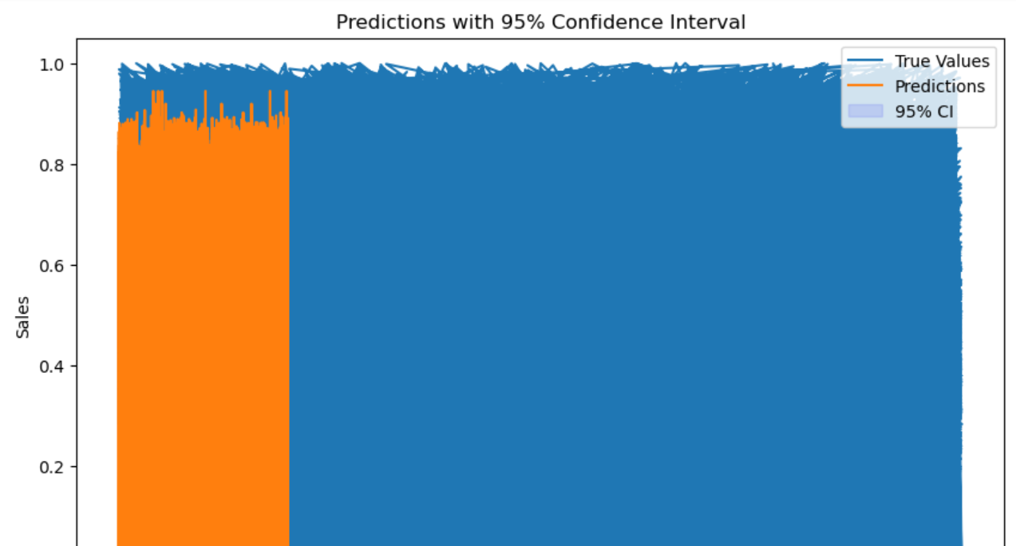

Slide 36
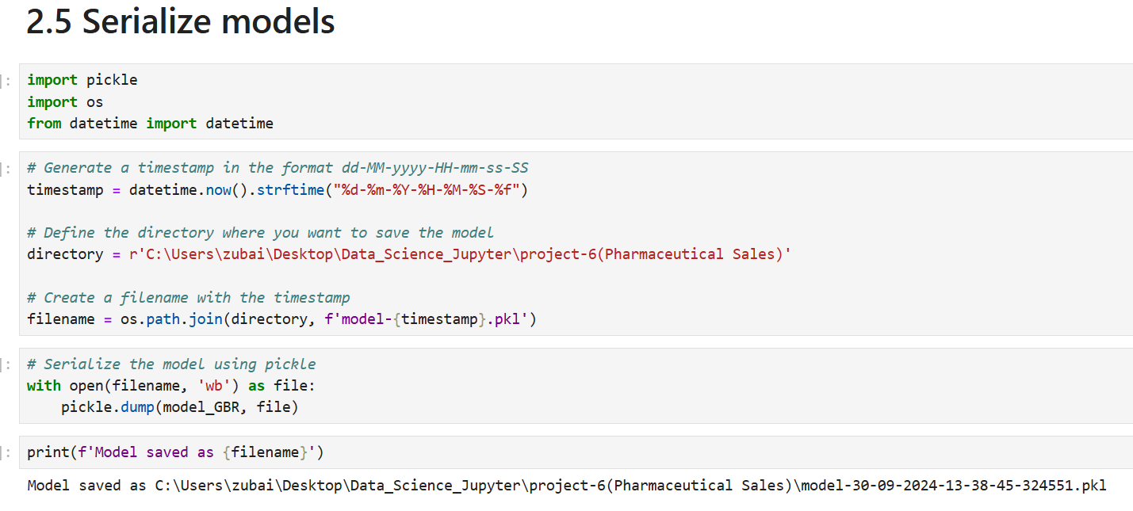
2.5 Serialize Models: Model serialization is essential for production deployment, especially when models need to be reused or updated regularly. Here’s how to handle model serialization:
Save the Model with Timestamp: Save each trained model with a unique timestamp to distinguish it from previous versions and enable model tracking.

Slide 37
Conclusion
This structured approach to store sales prediction, from preprocessing and modeling to post-prediction analysis and model serialization, sets a solid foundation for robust and insightful forecasting. Each step contributes to understanding the factors influencing sales and ensures the model's reliability in production environments.

Slide 38
Task 2.6: Building a Deep Learning Model with Long Short-Term Memory (LSTM) for Sales Prediction: Using deep learning for sales prediction can improve forecast accuracy by capturing temporal dependencies in data, making it ideal for time series analysis. Here, we will develop a Long Short-Term Memory (LSTM) model using TensorFlow or PyTorch to predict future sales.
Data Preparation:
Isolate Time Series Data: Select the time series data (e.g., date and sales) from the Rossmann Store Sales dataset for each store, arranging it in chronological order.
Stationarity Check: Use statistical tests, such as the Augmented Dickey-Fuller (ADF) test, to determine whether the data is stationary. Non-stationary data requires differencing.

Slide 39
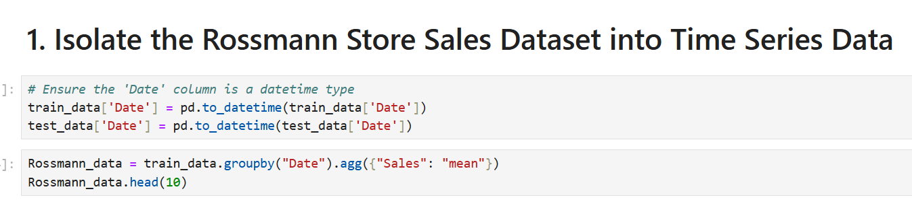
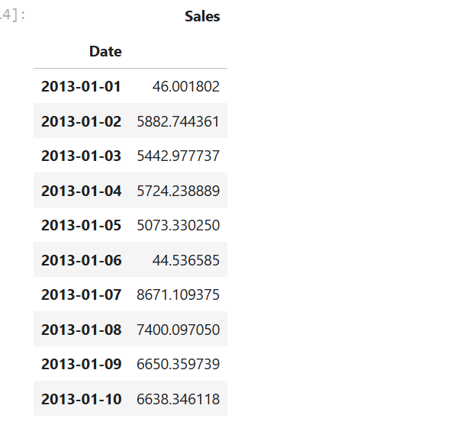

Slide 40
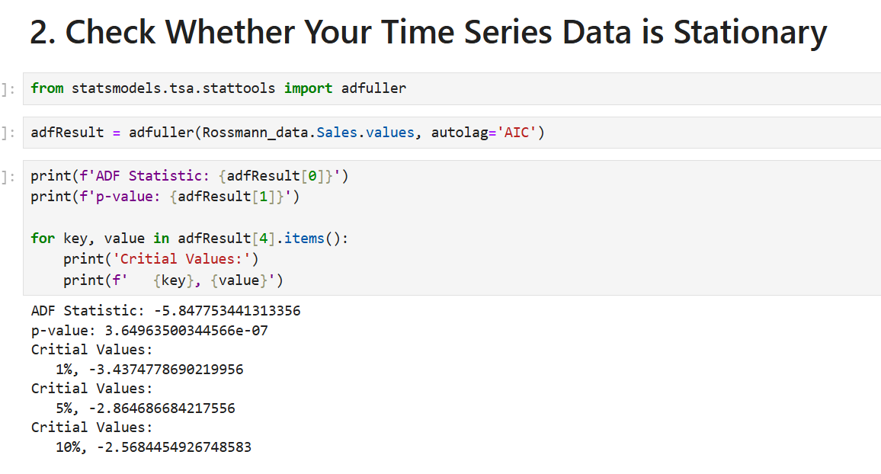

Slide 41
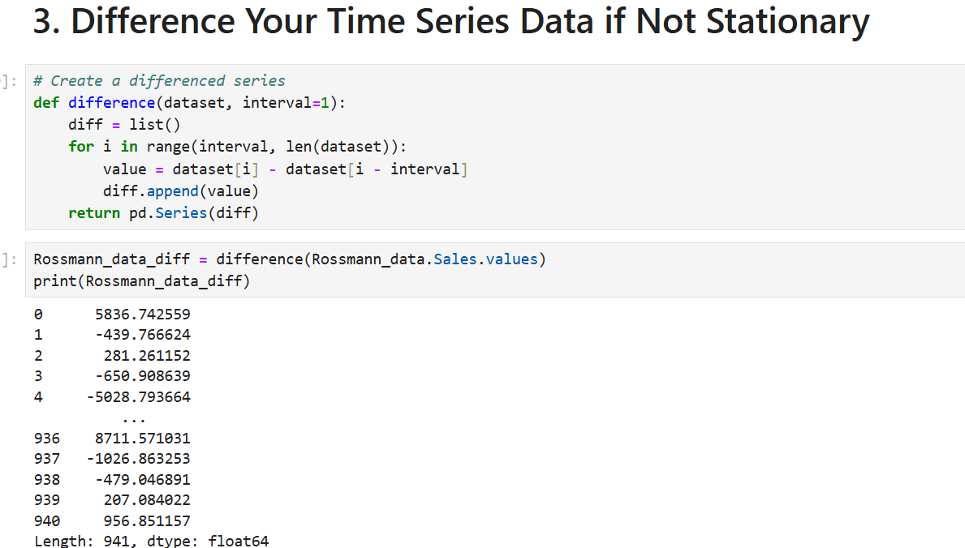
2. Differencing: If the time series data is non-stationary, apply differencing to remove trends, making the series more stationary.

Slide 42


3. Autocorrelation and Partial Autocorrelation: Visualize the autocorrelation (ACF) and partial autocorrelation (PACF) to understand any lagged dependencies in the sales data.

Slide 43


4. Scale Data: Scale the input features to the range of -1 to 1 for better training performance. Use MinMaxScaler from sklearn.

Slide 44


5. Transform to Supervised Learning Format: Use a sliding window to create lag features as input X and the next sales point as the target Y.
6. Split data into train and test sets: Scale the input features to the range of -1 to 1 for better training performance.

Slide 45

7. Build an LSTM Regression Model to Predict the Next Sales: Use TensorFlow (or PyTorch) to build a two-layer LSTM model for regression. The model should be lightweight to run efficiently in Google Colab.

Slide 46



Slide 47


Slide 48
Findings:
Time Series Data Preparation: Proper isolation and preparation of time series data are crucial for capturing temporal patterns and ensuring that the model can effectively learn from historical data.
Stationarity and Differencing: Checking for stationarity and differencing the data when necessary helps in stabilizing the time series, making it suitable for LSTM modeling and improving model performance.
Autocorrelation Insights: ACF and PACF plots provided valuable insights into the lag dependencies in the data, guiding the LSTM model configuration and ensuring relevant features are included.
Data Scaling: Scaling the data to a (-1, 1) range facilitated better convergence during model training and improved the overall performance of the LSTM model.
Model Architecture and Training: A two-layer LSTM architecture was effective for capturing complex temporal patterns and trends in the sales data. The model demonstrated good performance on test data, with a low MAE and RMSE, indicating accurate sales predictions.
Model Evaluation: The LSTM model's ability to predict future sales was validated through performance metrics, showing that it can effectively forecast sales based on historical data.
Deployment Readiness: The trained LSTM model can be deployed to make future sales predictions, providing valuable insights for store management and inventory planning.

Slide 49
2.7: Using MLflow to Serve Predictions: Using MLflow for model management allows for efficient tracking and deployment. Here’s how to serve the model using MLflow:
Log the Model with MLflow: Start by logging the trained model in MLflow for versioning and tracking purposes.
Load and Serve the Model: After logging, use MLflow’s model serving to deploy the model and make predictions on new data.

Slide 50
Chapter - 4
4. Results:
Limitations:
Data Quality: Inconsistent or missing values, especially in promotional or competition data, may impact model accuracy.
External Factors: The model doesn't account for unexpected events (e.g., economic shifts, natural disasters) that could affect sales.
eature Scope: Some relevant features, like local events or customer demographics, are not included due to data unavailability.
Model Complexity: Random Forest and LSTM models can be computationally intensive, impacting real-time scalability.
Temporal Dependencies: LSTM captures time patterns, but short sequences limit long-term trend understanding.
Overfitting: The model may overfit if tuning is insufficient, reducing generalization to unseen data.
Interpretability: Tree-based models offer some feature insights, but LSTM’s complexity makes interpretation challenging.

Slide 51
Recommendations:
Feature Expansion: Include additional data, such as regional economic indicators or customer demographics, to improve predictive power.
Dynamic Updates: Regularly update the model with new data to adapt to recent trends and seasonality.
Event Impact: Integrate data on special events or holidays to better capture sales spikes or drops.
Hyperparameter Tuning: Experiment with tuning to reduce overfitting and improve generalizability.
Longer Sequences: For LSTM, increase sequence length where feasible to capture longer-term trends.
Extended Predictive Window: Consider strategies like transfer learning to extend forecast accuracy beyond six weeks.

Slide 52
Chapter - 5
5. Conclusions:
Here's a step-by-step conclusion for the sales prediction project:
Exploratory Analysis Insights: The analysis highlighted key factors impacting sales, such as promotions, holidays, assortment types, and competitor proximity. These insights revealed patterns like the effect of promotions on customer behavior, weekend vs. weekday sales, and seasonal trends in purchasing, which are crucial for understanding customer dynamics.
2. Data Processing and Feature Engineering: Through comprehensive preprocessing, the data was cleaned, missing values were handled, and relevant features were engineered. Extracting features from date columns (e.g., holidays, month periods) improved the model’s ability to capture sales patterns effectively.
3. Model Development: A two-step modeling approach was used: first with tree-based models, particularly the Random Forest Regressor, for its interpretability and handling of complex data relationships. Then, an LSTM model was introduced to capture temporal dependencies in sales, offering insights into sales trends and seasonality.
4. Limitations: The model has some limitations, such as potential overfitting, lack of real-time adaptability to unexpected events, and interpretability challenges with complex models like LSTM. Additionally, the absence of external data factors, like economic trends, limits predictive accuracy for outlier events.

Slide 53
5. Recommendations:To enhance accuracy and robustness, incorporating new features (e.g., customer demographics or regional economic indicators), frequent model updates, and improved interpretability methods are recommended. Regular error monitoring would further support model adjustments based on recent sales patterns.
6. Business Impact: This project offers a strong foundation for data-driven decision-making. By accurately predicting sales, the model can support better inventory planning, resource allocation, and promotion timing, helping the company respond more effectively to demand fluctuations.
7. Future Directions: xtending the predictive window, refining time-based features, and exploring advanced modeling techniques will allow for a broader range of applications and further strengthen sales forecasting capabilities.
8. Final Remarks: In summary, this project demonstrates the practical application of machine learning in sales forecasting. The insights and predictions gained from the model have the potential to enhance the company’s operational efficiency, optimize resources, and improve customer satisfaction through timely and informed decision-making.

